Slide 1


Slide 2

Information about the
OAS Retirement and Pension Plan
Part 1: Introduction and Characteristics
OAS Retirement and Pension Fund
Daniel R. Vilariño
Secretary-Treasurer
2022
Washington, DC

Slide 3
Interesting facts:
The OAS Retirement and Pension Fund was created on May 2nd, 1928
  Preceded many of the social achievements of the international civil service community and many social security programs of the Americas
It is the 2nd oldest pension plan for any international organization in the World
  The oldest is the one for the International Bureau of Weights and Measures (BIPM from its French Acronym)
  But since BIPM is a technical organization, we can say that our Retirement and Pension Plan is the OLDEST for any political international organization!

Slide 4





Affiliated Institutions
Institutions of the Inter-American System currently affiliated to the Plan:
Organization of American States
Inter-American Institute for Cooperation on Agriculture
Inter-American Court on Human Rights
Inter-American Defense Board
Tropical Agricultural Research and
Higher Education Center

Slide 5
Participation
Participants from all 35 OAS member countries
Very rich multicultural environment and different ways to think about retirement benefits
There are participants that favor the idea of getting a pension
Some prefer to take a lump sum
And some prefer to combine benefits
The Plan is FLEXIBLE to accommodate all these options

Slide 6
Why do I need to participate in the Plan?
Because you need to PLAN
for your RETIREMENT!!!

Slide 7
To Plan
But, why do I need to plan?
Because there is a high level of probability that you will live until the retirement age and then, many more years after retirement.
During retirement, you will face financial requirements
Inflation will affect your financial situation
Financial well-being has a substantial effect on quality of life
You will probably want to be self-sufficient
Deteriorating health may increase your medical costs
Poor health will probably make you expend money to have
things done (home maintenance for example)

Slide 8
Distribution of Pensioners 2011 (by age)
Total number of Pensioners and Beneficiaries: 239, on September 14, 2011
7.0%
44.8%
28.9%
15.5%
3.8%
Edad ►
50
60
70
80
90
100
37
9
46 Pensioners and Beneficiaries,
19.3% of the total, are above 80 years of age
17
107
69

Slide 9
Distribution of Pensioners 2022 (by age)
Total number of Pensioners and Beneficiaries: 287, as of May 20, 2022
1.0%
23.0%
43.6%
24.4%
8.0%
Edad ►
50
60
70
80
90
100
70
23
93 Pensioners and Beneficiaries,
32.4% of the total, are above 80 years of age
3
66
125

Slide 10
The Plan, the Fund and
the Committee

Slide 11
The Retirement and Pension PLAN
The Plan
The OAS Retirement and Pension Plan is the document specifying the characteristics of a social security system implemented for the benefit of the employees of international organizations affiliated to the Plan.

Slide 12


The Retirement and Pension Fund
The OAS Retirement and Pension Fund works as a trust and is the group of resources used to finance the expenses incurred by the Committee during the Plan’s administration. It is composed of initial funds, institutional and personal contributions and interest generated by investments.
The Fund

Slide 13
The Retirement and Pension Committee
The OAS Retirement and Pension Fund Committee is composed of the Fund’s trustees, assisted by the Secretary-Treasurer and his/her Office, and the Legal Advisor. The Committee has the function of managing the Fund and enforce the Plan regulations.
The Committee

Slide 14
The OAS Retirement and Pension Fund Committee

Slide 15
Retirement & Pension Committee
Member States
Secretary General
Voice
&
Vote
Voice
&
Vote
Vice-Chair
Chair
Titular
Alternate
Secretary
Treasurer
Legal
Advisor
Voice
&
Vote
Voice
but NO
Vote
Titular
Alternate
Titular
Alternate
Participants
Pensioners

Slide 16
Retirement & Pension Committee
Member States
Secretary General
Amb. Lou-Anne Gilchrist
Mr. Jay Anania
Ms. Margarita Riva- Geoghegan
Mr. Héctor Arduz
Mr. Daniel Vilariño
Ms. Jeanette Carmona
Mr. William Berenson
Mr. Luiz Marcelo Azevedo
Ms. Beverly Wharton-Lake
Mr. Juan Cruz
Monticelli
Ms. Nelly Robinson
Participants
Pensioners

Slide 17
Characteristics of the Committee
Composed of 3 voting trustees plus a non-voting observer
The SG is one of them, normally appoints a representative
Chaired by the representative of the Member States
Meets at a minimum twice a year for accreditations
Quorum is 3 members (titular or alternate)
Vote is by majority
The Secretary-Treasurer is its Technical Secretary, the Legal Advisor and sometimes, other members of the Office of the Secretary-Treasurer also participate

Slide 18
Functions of the Committee
Manages the Plan and acts as the Fund’s trustee
Approves the operational budget
Gives guidelines to the Secretary-Treasurer, recommends his/her appointment
Adopts Plan’s policies and procedures
Decides semi-annual accreditations
Decides on Cost-of-Living Adjustments (when required)
Establishes investment policies satisfying the actuarial requirements

Slide 19
Functions of the Committee (continued)
Hires, evaluates and fires consultants, financial advisors, auditors, actuaries, and the Fund’s portfolio managers
Answers participants’ requests
Decides on legal claims
Recommends Plan Amendments
Produces annual reports to constituents
Designates sub-committees and working groups to study and report on pension related issues

Slide 20
Fiduciary Responsibility
The basic duty of a fiduciary is to act solely in the interest of the participants of the Plan and their beneficiaries and to provide benefits for them

Slide 21
Fiduciary Responsibility (continued)
To preserve the health and integrity of the Fund
To provide the best level of benefits to the participants and pensioners
To do so in the most effective way from the social and financial standpoints
To keep the Fund qualified under the Internal Revenue Code to maintain tax advantages
To cover present and future liabilities

Slide 22
Contributions and Vested Rights

Slide 23
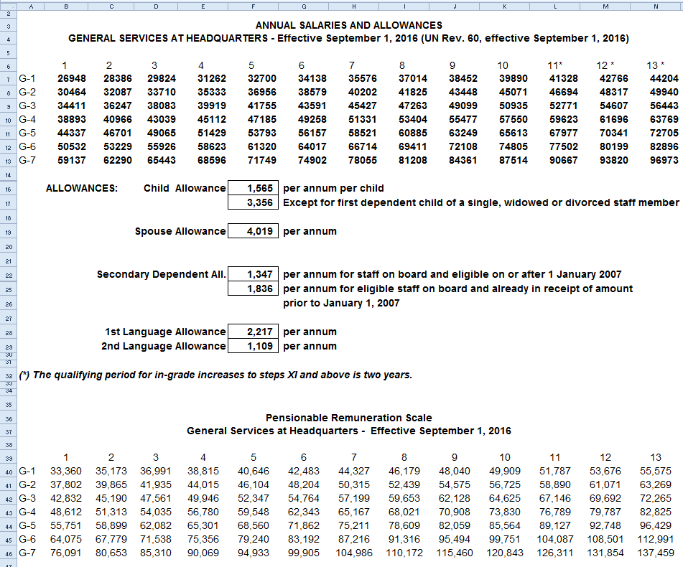
Salary Scale General Services

Slide 24
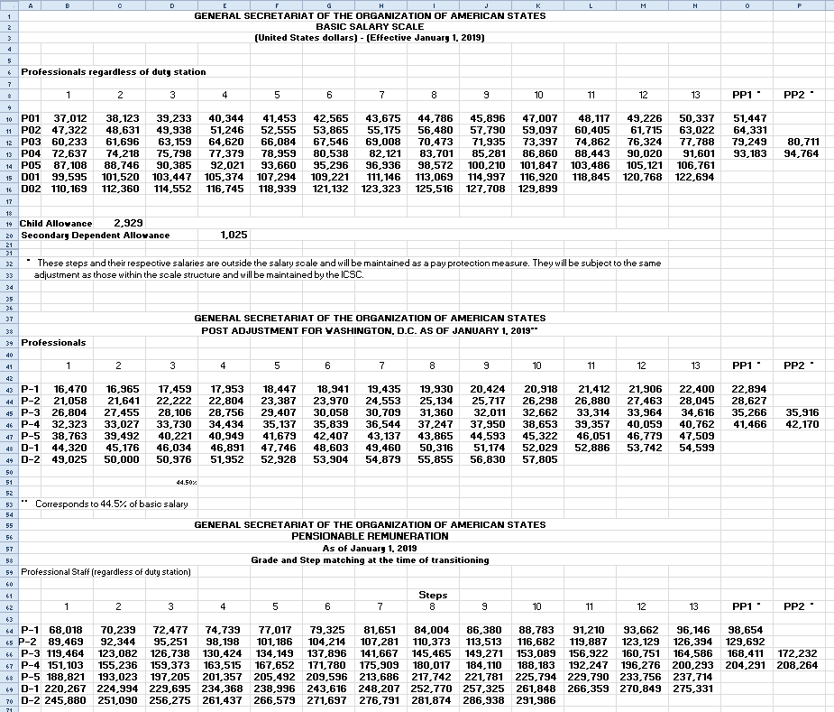
Salary Scale Professional Category

Slide 25
Contributions
For the OAS RETIREMENT AND PENSION PLAN
Institutional Contribution is 14%
of the Pensionable Remuneration
Participant Contribution is 7%
of the Pensionable Remuneration

Slide 26
Contributions
For the OAS RETIREMENT AND PENSION PLAN
Institutional Contribution represents
2/3 of the Total Contribution
Participant Contribution represents
1/3 of the Total Contribution

Slide 27
Vesting Rights
Institutional Contributions*
100%
Participant Contributions*
80%
60%
35%
35%
35%
35%
40%
100%
100%
100%
100%
100%
100%
100%
100%
Start
1 Year
2 Years
3 Years
4 Years
5 Years
6 Years
7 Years
*Institutional Contributions include the interest generated by those contributions, and Participant Contributions include the interest generated by those contributions

Slide 28
Contributions
For the PROVIDENT PLAN
Institutional Contribution is 5%
of the Pensionable Remuneration
Participant Contribution is 5%
of the Pensionable Remuneration

Slide 29
Contributions
For the PROVIDENT PLAN
Institutional Contribution represents
½ of the Pensionable Remuneration
Participant Contribution represents
½ of the Pensionable Remuneration

Slide 30
Vesting Rights
Institutional Contributions*
Participant Contributions*
For the OAS PROVIDENT PLAN
100%
100%
100%
100%
100%
100%
100%
100%
100%
100%
100%
100%
100%
100%
100%
100%
Typically, the participation in the Provident Plan is for less than a year, only in very few cases may extend for several years.
Start
1 Year
2 Years
3 Years
4 Years
5 Years
6 Years
7 Years
*Institutional Contributions include the interest generated by those contributions, and Participant Contributions include the interest generated by those contributions

Slide 31
Health of the Fund

Slide 32
Tools for Pension Policy Definition
year n
year n+1
year n+2
year n+3
year n+4
year n+5
year n+6
year n+7
Actuarial Studies
Asset/Liability Studies
Actuarial studies are performed in even years
Asset/Liability studies are performed in odd years
Investment Advisor reports
Annual External Audits

Slide 33
Our Fund vs other public funds:
How does our Retirement and Pension Fund compare to other public funds?
The US National Association of State Retirement Administrators, performed a study that agglomerated 120 state public funds, which, altogether represent more than 3.5 trillion US dollars in assets and that showed that between 2012 and 2020, the average funded ratio of these funds oscillated between 71.8% and 73.7%.
In an environment where a fund with a funded ratio above 90% is considered to be in very good health, the Retirement and Pension Fund had a funded ratio of 107% at the end of 2021.

Slide 34
Health of the Fund:
The use of the tools for policy definition allow the Committee and the Fund’s Secretariat to adjust these policies to keep the Fund healthy
The last actuarial study determined that the Fund had a funded ratio of 100% as of December 31, 2020.
Besides all the studies mentioned above, our actuaries update the funded ratio every quarter
  At the end of the 1st Q of 2021 the funded ratio was 102%
  At the end of the 2nd Q of 2021 the funded ratio was 103%
  At the end of the 3rd Q of 2021 the funded ratio was 104%
  At the end of the 4th Q of 2021 the funded ratio was 107%

Slide 35
Your Representatives in the Committee:
Luiz Marcelo Azevedo (Principal Representative)
  Tel. (202)370-0672
  lazevedo@oas.org
Juan Cruz Monticelli (Alternate Representative)
  Tel. (202)370-4878
  jmonticelli@oas.org

Slide 36
Contact Information
Daniel R. Vilarino (Secretary-Treasurer)
  Organization of American States
  Office of the Retirement and Pension Fund
  1889 F. Street, N.W. Office TL-50
  Washington, D.C., 20006
  Tel. (202)370-5430
  dvilarino@oas.org
  http://www.oas.org/retirementfund
Jeanette Carmona
  jcarmona@oas.org
oasrpf@gmail.com

Slide 37





Questions?

Slide 39
Information about the
OAS Retirement and Pension Plan
Part 2: Benefits
OAS Retirement and Pension Fund
Daniel R. Vilariño
Secretary-Treasurer
2022
Washington, DC

Slide 40
Types of Plans
Defined Benefit (DB) Plans
  In DB Plans the sponsor promises to pay the participant a pre-determined amount of money (generally in the form of a pension) based normally in the number of years of participation and the remuneration during the last years of participation. Contributions may change over time and the benefit is not dependent on the market performance.
Defined Contribution (DC)
  In DC Plans the contributions are fixed. Each participant has his/her account and what he/she gets at the end will depend on investment performance.

Slide 41
Plan Overview
The OAS Retirement and Pension Plan is a DB plan, with some DC features
It provides the following types of benefits:
  Pension or lump sum at age of retirement or separation
  Disability pension or benefits
  Survivorship pension or benefits for remaining spouse and children
  Voluntary retirement
  Minimum alternate pension for low-income participants
  Reduced vesting period
  Cost of Living Adjustments (COLAs)

Slide 42
Plan Overview (continued)
Although the Retirement and Pension Plan is mainly a Defined Benefit plan, the institutional contributions do not change over time (a Defined Contribution feature)
The plan defines benefits in terms of age, years of participation, and the average pensionable remuneration during the last few years of participation
This is the Defined Benefit window of the Plan that attempts to provide long term protection

Slide 43
Plan Overview (continued)
An account is maintained for each participant
The account will not decrease with adverse markets (as it may happen in most DC plans)
Both the personal and the institutional contributions are credited to this account
Interest is also credited periodically
This is the Defined Contribution part of the Plan
Participants build credit over a short period of time in case they separate or they are terminated before they qualify for a pension

Slide 44
Plan Overview (continued)
The combination of Defined Benefit and Defined Contribution characteristics has provided for considerable flexibility for our participants
However, the accreditation feature presents interesting challenges for the managing of our Plan
The accreditation policy evolved with time to confront these challenges and maintain a healthy and funded status

Slide 45
Plan Overview (continued)
A Pension given by the Defined Benefit Formula
The participant has the best of both worlds because the risk of market performance is borne by the Fund, but the accounts do not decrease with adverse markets.
Lump Sum cash payment
DB
Participant
retiring or separating
An Annuity purchased with funds in his/her account
DC

Slide 46
To qualify for a pension or annuity
Less than 15 years of participation
Less than 55 years of age
15 years or more of participation in the Plan
55 years or more of age
Participant qualifies for a Pension or to buy Annuity
Participant receives benefit as a
Lump Sum

Slide 47
Rule of 85
85
Years of
Participation
in the Plan
Age
For each year of participation, a participant adds two points to the formula, one for participation and one for age
When the participant reaches the age of 65, (Compulsory Retirement) the formula is no longer applicable

Slide 48
Actuarial Correction
85
Years of
Participation
in the Plan
Age
The participant is too young, pension has to be paid for more years
The participant is close to 65 years of age, but has few years of contributions
The actuarial correction reduces the pension to compensate for these two situations

Slide 49
Types of Retirement: 1. Compulsory
Years of
Participation
≥ 15
Retirement
Age = 65
Compulsory
Retirement
For Compulsory Retirement, the rule of 85 is NOT CONSIDERED.
There is NO Actuarial Correction.

Slide 50
Types of Retirement: 2. Voluntary
Participation + Age
≥ 85
Voluntary
Retirement
55 ≤
Retirement
Age < 65
Years of
Participation
≥ 15
For voluntary retirement, the participant MUST COMPLY with the rule of 85.
There is NO Actuarial Correction.

Slide 51
Types of Retirement: 3. Early
Participation + Age
< 85
Early
Retirement
55 ≤
Retirement
Age < 65
Years of
Participation
≥ 15
In early retirement, the participant DOES NOT COMPLY with the rule of 85.
Still can take a pension, BUT THERE IS Actuarial Correction.

Slide 52
Types of Retirement: 4. Deferred
Benefits START at
AGE 65
Deferred
Retirement
Retirement
Age < 65
Years of
Participation
≥ 15
The participant may retire early complying or not with the Rule of 85.
Benefits begin (are deferred) at age 65, NO Actuarial Correction.

Slide 53
Separation
Institutional Contributions*
100%
80%
Participant Contributions*
60%
35%
35%
35%
35%
40%
Years of
Participation < 7
100%
100%
100%
100%
100%
100%
100%
100%
Year 0
1
2
3
4
5
6
7
7+
Liquidated according to vesting schedule. Previous participations can be reinstated to accumulate more years of participation and increase vesting.
*Institutional Contributions include the interest generated by those contributions, and Participant Contributions include the interest generated by those contributions

Slide 54
Separation
Less than 15 years of participation
Less than 55 years of age
When the Participant has more than 7 years of participation but does not comply with the criteria for a pension, then he/she receives a lump sum payment.

Slide 55
Benefits: Pensions
There are three methods for calculating a Pension
2% Formula
Alternative
Minimum
Pension
Annuity

Slide 56
Average Pensionable Remuneration (APR)
2% Formula
Last 5 years of participation
4 years before the last
J
F
M
A
M
J
J
A
S
O
N
D
3 years before the last
J
F
M
A
M
J
J
A
S
O
N
D
2 years before the last
J
F
M
A
M
J
J
A
S
O
N
D
year before the last
J
F
M
A
M
J
J
A
S
O
N
D
Last year of participation
J
F
M
A
M
J
J
A
S
O
N
D
Is the average of the best 36 consecutive months’ pensionable remunerations within the last five years of participation (most of the time the average of the last 3 years)

Slide 57
Average Pensionable Remuneration (continued)
2% Formula
Last 5 years of participation
4 years before the last
J
F
M
A
M
J
J
A
S
O
N
D
3 years before the last
J
F
M
A
M
J
J
A
S
O
N
D
2 years before the last
J
F
M
A
M
J
J
A
S
O
N
D
Year before the last
J
F
M
A
M
J
J
A
S
O
N
D
Last year of participation
J
F
M
A
M
J
J
A
S
O
N
D
It may happen, sometimes, that the best 36 consecutive months are not the last 3 years.

Slide 58
Average Pensionable Remuneration (APR) example
2% Formula
Last 5 years of participation
4 years before the last
$8550
$8550
$8550
$8550
$8550
$8550
$8550
$8550
$8550
$8790
$8790
$8790
3 years before the last
$9030
$9030
$9030
$9030
$9030
$9030
$9030
$9030
$9030
$9170
$9170
$9170
2 years before the last
$9420
$9420
$9420
$10500
$10500
$10500
$10500
$10500
$10500
$10500
$10500
$10500
Year before the last
$10800
$10800
$10800
$10800
$10800
$10800
$10800
$10800
$10800
$10800
$10800
$10800
Last year of participation
$11100
$11100
$11100
$11100
$11100
$11100
$11100
$11100
$11100
$11100
$11100
$11100
The Average Pensionable Remuneration in this example is $10,710.

Slide 59
What is the 2% Formula?
2% Formula
It is 2% of the APR for each year of
participation up to 30 years.
Then, it is 1 ²/₃% for each year
from year 31 up to year 40.
In the previous example, if the person participated 25 years, the pension would be 2%x25x$10710 = $5,355
If the person participated 30 years, the pension would be 2%x30x$10710 = $6,426
If the person participated 35 years, the pension would be $6426 + 1.67%x5x10710 = $7,320

Slide 60
2% Formula: Process
2% Formula
2% Formula
Age
Mínimum: 2/3 as a pension
Years of
Participation in
the Plan
Pension
Value
Lifetime Accumulated Pension Value
Average
Pensionable
Remuneration
Up to
1/3 in
cash
Actuarial Correction?
Actuarial Tables

Slide 61
Characteristics
2% Formula
Beneficiary has a survivor pension benefit equal to 50% of the pensioner’s pension.
They have Cost of Living Adjustments.
It is a lifetime pension (Life of the pensioner and life of the beneficiary after the pensioner passes away).
Rule of 85 is evaluated to determine if there is an actuarial correction.

Slide 62



Annuity
Annuity
Cash
Part
Annuity
Part
in Cash
Annuity
Can
Take
Funds in the
Pariticipant’s
Account
Month 1
Month 2
Month 3
Month N
Month
N + 1

Slide 63
Annuity Computation
Annuity
Participant’s age
Age of Participant’s Spouse
Funds in the participant’s account
Funds dedicated to get an annuity
Annuity
Spouse’s protection level
Actuarial factors
Fund taken in cash
0%
50%
100%

Slide 64
Example
Annuity
Age:
65 Male
Spouse’s Age:
65 Female
Funds:
$1,000,000
For Annuity
$750,000
Annuity:
$49,508 per year
$4,126 per month
Level of Protection to the Spouse
Actuarial Factor
15.149
Cash:
$250,000
0%
50%
100%

Slide 65
Characteristics
Anualidad
Beneficiary has a survivor pension benefit equal to 0%, 50% or 100% of the pensioner’s annuity depending on what the pensioner decided when he/she retired.
They have Cost of Living Adjustments.
It is a lifetime pension (Life of the pensioner and life of the beneficiary after the pensioner passes away).
The rule of 85 does not apply.

Slide 66
Alternative Minimum Pension
Alternative Minimum Pension
60% of Average Basic Salary
Age
Minimum
of 2/3 in
the form
of a
Pension
15 or more years of participation
Pension Value
Lifetime accumulated pension value under 2% Formula
55 or more years of age
Up to
1/3 in
Cash
Actuarial Reduction?
Actuarial
Tables

Slide 67
Characteristics
Alternative Minimum Pension
Beneficiary has a survivor pension benefit equal to 50% of the pensioner’s pension.
They have Cost of Living Adjustments.
It is a lifetime pension (Life of the pensioner and life of the beneficiary after the pensioner passes away).
The same rule of 85 is evaluated to determine if there is an actuarial correction.

Slide 68
Which one is the best option?
2% Formula
Annuity
Alternative
Minimum
Pension
The Office of the Secretary-Treasurer of the Retirement and Pension Fund will calculate the three options and the most convenient can be obtained by comparison.

Slide 69



Pensions Advantages and Disadvantages
Representation in Committee ASPEN
Protection against law suits
Priority claim of resources
Provide diversification
Less worries about risks
It has cost of living adjustments
Lifetime pensions
Premature death
Health of participant and spouse

Slide 70

Lump Sum
Lump Sum
It is a onetime payment in cash to the participant equivalent to the amount in the participant’s Fund account.
Depends on the vesting schedule
Decision is irrevocable, once the payment is completed, participant cannot come and request the payment of a pension

Slide 71
Lump Sum Pros and Cons
Lump Sum
Knowledge, will power and character to manage assets
Spouse’s retirement benefits
Health of participant and spouse
To pay off debts
Bad investments, loss of capital
Large investment
Market, financial and other risks
Legacy to family
No protection against law suits
Premature death?
Long life without adequate resources

Slide 72
Considerations
Lump Sum
You have to manage the obtained resources to generate regular income
Try to compare this income to a pension under similar circumstances (lifetime, cost of living adjustments)
Try to identify investment instruments that offer similar level of security like those of a pension
Try to get a diversification that will provide the same level of low risk as a pension
Try to design an investment policy that will preserve capital and provide a regular source of income for a low risk level
Consider the situation of beneficiaries

Slide 73

Options:
Annuity
CASH……..
2%
Formula
COMBINATION
COMBINATION
Alternative Minimum Pension
COMBINATION

Slide 74
Pension and Cash Combinations
It is a hybrid option that combines advantages of lump sum payments with advantages of pensions (or annuities)
The combination provides a base of regular income through a reduced pension payment
The lump sum payment provides the advantage of making large disbursements
Pay off debts, mortgage
Buy a second house
Leave inheritance to children/beneficiaries
When receiving a lump sum payment the value of the pension is reduced proportionally

Slide 75
Survivor Benefits
Spouse and Children*:
Spouse receives 50% of the account
Children receive 50% of the account
(distributed in equal parts)
Only Spouse there are no Children:
Spouse receives 100% of the account
Participant dies with less than 5 years of participation
Only Children there is no spouse:
Children receive 100% of the account
(distributed in equal parts)
There are no spouse or children:
The participant contributions** are
distributed as instructed in the
designation of beneficiaries
*The definition of children is as per paragraph 1, section VI of the Retirement and Pension Plan
**The participant contributions include the interest generated by these contributions

Slide 76
Survivor’s Pension (Base Pension)
Participant dies with 5 or more years of participation
The first step is to determine a base pension
The base pension is computed assuming that the age of the participant was 65
even when the participant was younger at the moment of his/her death
The base pension is computed assuming that the participation was 15 years
even if the participation was less than 15 years at the moment of the death.
If participation was longer than 15 years, then the actual value is used.

Slide 77
Survivor’s Pension (Percentages)
Spouse:
Receives a pension equivalent to
50% of the Base Pension
It’s a lifetime pension and has COLAs
Children:
Each minor child (18 o 21)* receives
10% of the Base Pension, with COLA
Until adult, 25% combined maximum
Participant dies with 5 or more years of participation
Permanently disabled Child:
(After death of the spouse)
50% of the Base Pension
Lifetime and has COLAs
Several, 50% is the combined maximum
There are no spouse or children:
The Participant Contributions** are
distributed as instructed in the
designation of Beneficiaries
*21 years if the child studies full time
**The participant contributions include the interest generated by these contributions

Slide 78
Disability Benefit
Participant becomes physically or mentally disabled with less than 5 years of participation and cannot work anymore
The participant receives 100% of what he/she had in the account.
The vesting schedule is not applied.

Slide 79
Disability Pension
Participant becomes phisically or mentally disabled with 5 years or more of participation and cannot work any longer
The disability pension is computed assuming that the age of the participant was 65 even if the participant was younger at the moment he/she becomes disabled
The disability pension is computed assuming that the participation was 15 years, even when the participation was less than 15 years at the moment the participant became disabled. If the participant had a participation longer than 15 years, then the actual value is used.

Slide 80
Notifications
Cases of widows and widowers who receive survivor’s pension and pensioners under disability pension:
If these pensioners work, the value of their pensions is reduced to 50 cents of a dollar per dollar earned with their work in the previous year.
Some situations do not happen very often and it is difficult to cover all the cases in this presentation, in case of doubt, please communicate with the Office of the Secretary-Treasurer

Slide 81
Designation of Beneficiaries
According to what was shown before, the Plan automatically designates beneficiaries like spouse and children
However, it is still important to fill out and maintain updated designation of beneficiaries in the case when there are no longer beneficiaries designated by the Plan
The participant can update the designation of beneficiaries as often as the participant considers it convenient and the last one in our archives is the one valid

Slide 82
Designation of Beneficiaries
If a participant dies and there is no Plan designated beneficiaries nor a designation of beneficiaries, the personal contributions will be distributed to the participant’s Estate
The designation of beneficiaries is also important in the case that there is no spouse and the children have reached adulthood, and there are still funds available once deducted the pension payments
UPDATE your DESIGNATION of BENEFICIARIES!!!

Slide 83
Tus Representantes en la Comisión:
Luiz Marcelo Azevedo (Representante Principal)
  Tel. (202)370-0672
  lazevedo@oas.org
Juan Cruz Monticelli (Representante Alterno)
  Tel. (202)370-4878
  jmonticelli@oas.org

Slide 84
Contact Information
Daniel R. Vilarino (Secretary-Treasurer)
  Organization of American States
  Office of the Retirement and Pension Fund
  1889 F. Street, N.W. Office TL-50
  Washington, D.C., 20006
  Tel. (202)370-5430
  dvilarino@oas.org
  http://www.oas.org/retirementfund
Jeanette Carmona
  jcarmona@oas.org
oasrpf@gmail.com

Slide 85
Questions?

